Slide 1

Multiple Linear Regression Analysis on S&P 500 dataset
Western Governors University
By: Christian LeBlanc

Slide 2
About me
Christian LeBlanc
Bachelor degree from University of Louisiana
Business analysis at a Fortune 500 company

Slide 3
Problem
Can a Multiple Linear Regression (MLR) model indicate which stocks in the “Big Tech” group have the strongest influence on the S&P 500 index?

Slide 4
Hypothesis
H0: A MLR model does not show which stocks in the “Big Tech” group has the strongest influence on the S&P 500 index.
Ha: A MLR analysis does show which stocks in the “Big Tech” group has the strongest influence on the S&P 500 index.

Slide 5
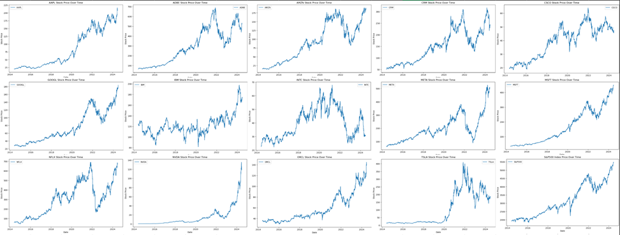
Data-analysis Process

Slide 6
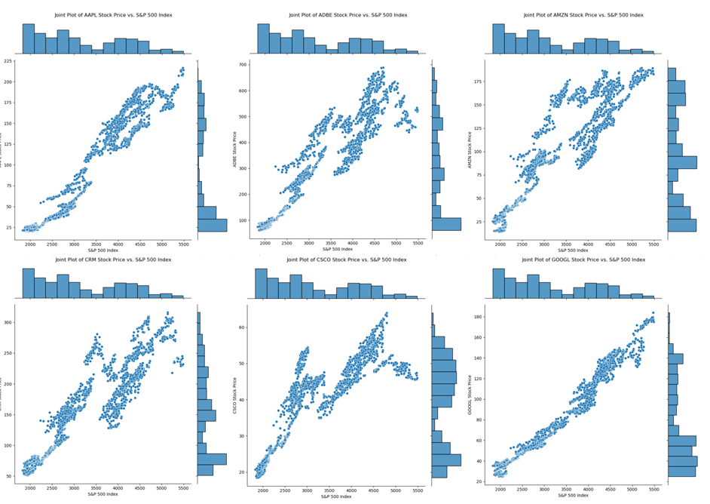
Data-analysis Process

Slide 7
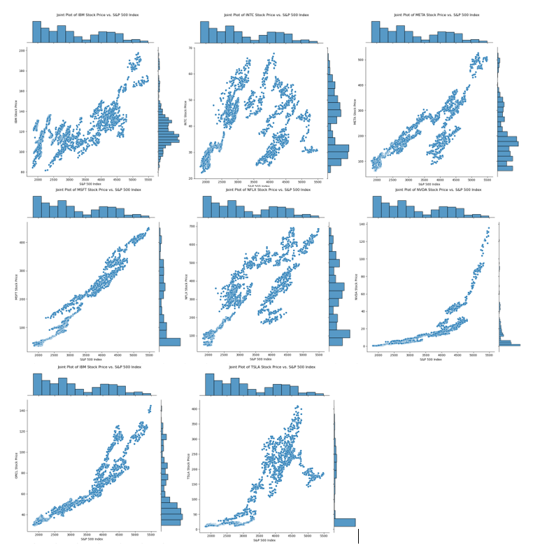
Data-analysis Process

Slide 8
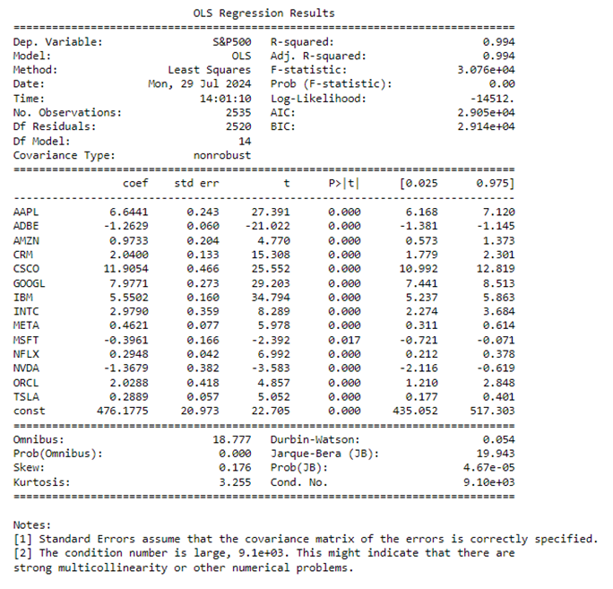
Data-analysis Process

Slide 9
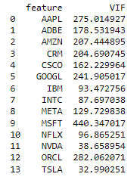
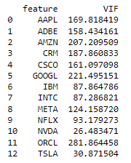
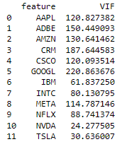
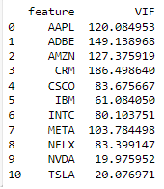
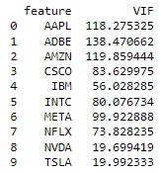
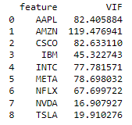
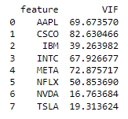
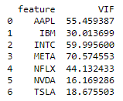
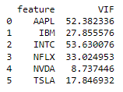
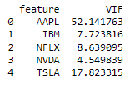

Data-analysis Process

Slide 10
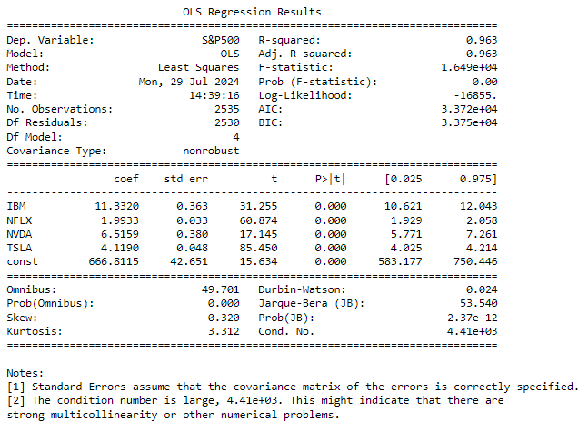
Data-analysis Process

Slide 11
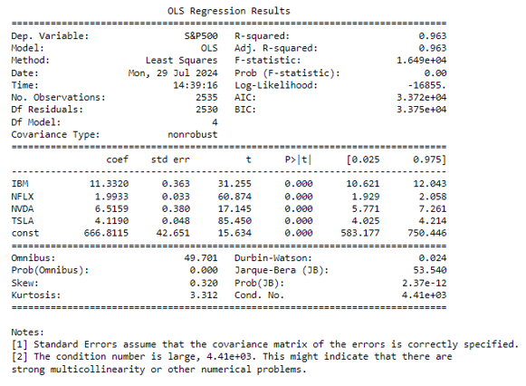
Findings

Slide 12

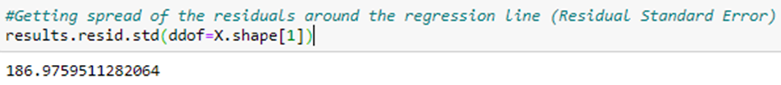
Findings

Slide 13
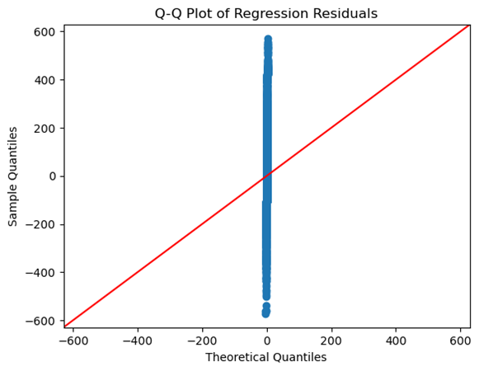
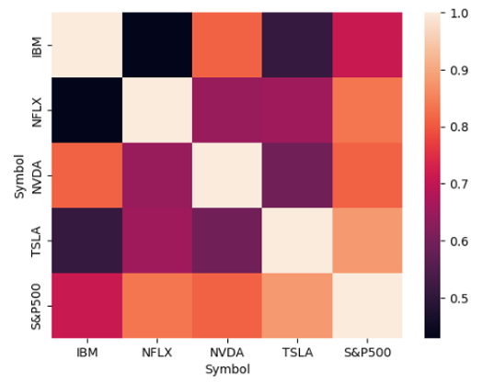
Findings

Slide 14
Limitations
A significant amount of manipulation to the data was required to fit the model.
Even though the dataset contained all the information needed, the format led to additional preparation steps.
Repetitive steps, such as filtering dates multiple times caused redundancy.
This extended the analysis duration and introduced inefficiency.

Slide 15
Limitations
The OLS model requires several assumptions to be true to give consistent and reliable results.
The violation of these assumptions undermines the results.

Slide 16
Limitations
The analysis was limited to a small selection of stocks from the S&P 500 index.
While focusing on a few stocks, the analysis may miss broader insights that could be obtained by including all 500 stocks in the model.

Slide 17
Proposed Actions
It is recommended to not use this model for any insights or actions.
This is still a topic that would be interesting to get useful information from.
There are two different directions further analysis should investigate.
It would be interesting if including all 500 would help the model to become useful.
Find other metrics in the economy that are not stocks and see if a MLR can be built and useful.

Slide 18
Expected Benefits
The disappointing results of the study makes it hard to expect benefits from it.
The hope was that finding the stocks with strong influence on the S&P 500 index could help build a stock portfolio that would beat the index in performance by including the strongest influences and not including any negative influences.

